Slide 1

Inference Without Assumptions:
Detecting and Rewriting Social Bias
In Natural Language Inference.
​
Names:
Ariel Soffer​
Katherine Zablianov​​
Shay Yeffet​
Neta Robinzon Butbul​
Notes:
1

Slide 2
Problem Description and Objectives
Problem:
Natural Language Inference (NLI) systems often make gender-based assumptions when the context is insufficient. These assumptions can reflect harmful stereotypes and introduce social bias into applications like chatbots, search engines, or summarization tools.
Why it's important:
Biased language models can reinforce social inequalitie.
Misgendering and unwarranted gender inference harm user trust and fairness.
Ensuring balanced gender representation in AI outputs is essential for ethical deployment
Why it’s hard:
Gender bias in natural language is often subtle, contextual, and embedded in seemingly neutral language .
Many professional or social roles do not imply gender, but models often infer one anyway.
Addressing this requires context-aware detection and careful controlled rewriting of outputs.
Project Objectives:
Detect biased NLI sentence pairs where the second sentence introduces a gender reference not justified by the first.
Fine-tune baseline models by using pre-trained SBERT model, to classify sentence pairs as biased or not.
Use API loop with instructions to test ChatGPT3.5 and 4o as classifiers.
Use GPT-4o model to rewrite biased outputs with balanced gender ratio of male and female sentences .
Evaluate the effectiveness of rewriting using embedding-based bias scoring.
Compare freezing strategies, model types, and prompting styles in both detection and mitigation stages.
Notes:
2

Slide 3
Formal Task Specification
Task 1: Bias Detection
Input:
Synthetic data we created of sentence pairs (Premise - first sentence, and Hypothesis - second sentence)
where the first sentence (the premise) describes a role, profession, a relative, of other person, and the second sentence (the hypothesis) include a gender term (like he, she,her, him,...) that refers to that entity .
Output:
Classification labels - "1" or "0".
If gender in the second sentence is assumed without justification from the first sentence (“My friend is a lawyer. She works...") , then it is biased, and label=1
In any other case - if the gender term in the second sentence is inferable and clear (“My mother is a lawyer. She works...), the pair is not biased and label=0
Metrics:
Classification Accuracy, F1, Recall, Precision
Task 2: Bias Mitigation (Rewriting)
Input: Sentence pairs labeled as biased from our original dataset
Output: Rewritten versions of the hypothesis (second sentence): rewritten gender-balanced sentences – expecting half of them to have a male term (like "he") and the other half to have a female term (like "she")
Metrics: Cosine similarity to “man”/“woman” embeddings , mean of distances ≈ 0
Notes:
3

Slide 4
High Level Plan
Data generation/labeling: create a synthetic dataset with labels by using generative models, prompt engineering and other specific labeling strategies (building and using names list and gender terms list of terms from our dataset and more)
Detection: Compare generative models like GPT-3.5, GPT-4o vs pretrained SBERT with different freezing-layers strategies and validation on labeled test partition
Rewriting: using generative LLMs like GPT4o to rewrite the biased sentences to be male/female sentences with a probability of 0.5
Evaluation Metric: measuring the cosine similarity between each sentence and static embeddings for “man” and “woman,” assigning a directional score that indicates whether the sentence leans to "male" of "female". Then adding 1/-1 accordingle and calculating average bias score.
Validation: Expect biased sets |score| >> 0, expect rewritten sets |score| ≈ 0 for successful debiasing
Notes:
4

Slide 5
Prior Art
Source/Title | Task Solved | Approach/Model | Data | Metrics | Results
“Counterfactually Augmented Data Improves Robustness in NLI” (Kaushik et al., 2020) | Robust NLI classification and fairness through counterfactual examples | BERT fine-tuned on original + human-edited counterfactuals | SNLI + counterfactual edits | Accuracy, Robustness Gap | Improved generalization and reduced reliance on biased heuristics
“BERT for Natural Language Inference” (Devlin et al., 2019, original BERT paper) | Sentence-pair classification including NLI | Fine-tuning pre-trained BERT on NLI datasets | MNLI, SNLI, SciTail | Accuracy | Achieved state-of-the-art performance on MNLI and GLUE benchmark
“StereoSet: Measuring stereotypical bias in pretrained language models” (Nadeem et al., 2021) | Evaluating social and gender bias in pretrained language models | StereoSet benchmark applied to BERT, RoBERTa, GPT-2 | StereoSet (stereotype vs. anti-stereotype triplets) | Bias score, LM score | Most LMs showed bias toward stereotypical completions

Slide 6
Data Preparation/Description
Name: labeled_dataset1
Link: dataset_link
Fields:
Sentence1: a general sentence that describes a situation with a person/role/profession without refering to its gender.
Sentence 2: a sentence that continues the privious one and mentions the gender of the person that was mentioned in it.
Label: 1 if there is contextual bias (gender term in sentence 2 can not be concluded from sentence 1), and 0 if there is not.
Data generation:
Using GPT4o model to create prompt instructions for a generative model
Improving the instruction and giving it to GPT 4o in a new session
Generating 30 samples each time, to acheive stability and diversity of samples
Based on generated samples, improving instructions and getting more accurate and relevant results
Notes:
6

Slide 7
Data Preparation/Description
Labeling process:
Collecting all terms from sentence 1 that indicate the gender of a person, like: aunt, father, Sean, Sister, Lily (names and family-gendered-terms) and creating 2 lists from them: one for family terms and the other for names.
Writing code that searches for one of the words from these lists in the first sentences, and if it finds one, it labels them as not biased=0. Otherwise, they are labeled as biased=0
To solve the problem of unisex names, we went through every name in the list of names we created, and constructed all Unisex names
We wrote another code that find these Unisex names, and replaces them with explicit gender names
Date properties:
Total Samples: 3,421 sentence pairs (3419 valid ones after cleaning nulls)
Label Distribution (after cleaning and dropping nulls):
Label 0: 1760 samples (about 50%)
Label 1: 1659 samples (about 50%)

Slide 8
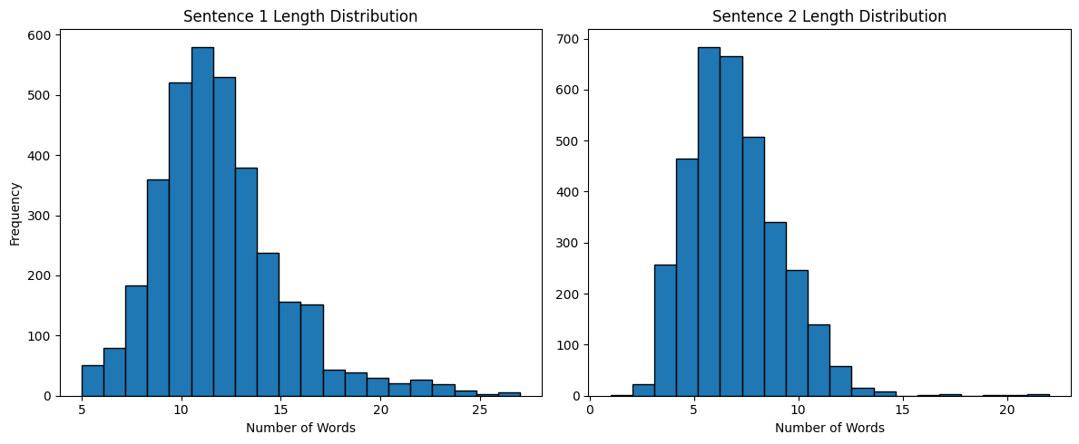
Data Preparation/Description
Input Features:
Vocabulary diversity: High — includes hundreds of professions, hobbies, family terms, and name variants
Lenth of input diversity: the length of sentence 1 and sentence 2 are different and diverse:
Example of a sentence in our dataset (and for the label given to it):
Sentence 1: “The firefighter, soaked in sweat, emerged with a rescued puppy.”
Sentence 2: “His bravery stunned the crowd.”
Label: 1 (Biased)
Explanation:
The pronoun "his" refers to the firefighter without knowing the gender. Since "firefighter" is a neutral form and in the second sentence the presumption is that it is a male, the gendered reference is not supported and thus, biased.
Notes:
8

Slide 9
Models
Chat GPT 4o/3.5 as a classifier model –
These models label 30 samples each time as biased/not biased in a loop we created, using API, and this way give their predictions.
They do not train on any data, but use zero-shot inference based on instructions.
The code is written on colab.
Pre-Trained SBERT (sentence BERET) models with a classification head:
There are 3 versions of fine tuned SBert models:
One with 25% frozen layers (3 out of 12)
One with 50% frozen layers (6 out of 12)
One with 100% frozen layers (all 12 layers exept the classification head)
each model is pretrained on (NLI) datasets such as SNLI and MultiNLI, where the task involves determining the relationship (entailment, contradiction, neutral) between pairs of sentences and this is the reason we chose the SBert model (this task reminds our current one).
all 3 models are attached to a linear layer that represents the classification head
Embedding Layer: Unfrozen (trainable) in all 3 models for better adaptability
Train-test-validation split:
Train: 70% | Validation: 15% | Test: 15%
Notes:
9

Slide 10
Models
Configuration (SBert fine tuned models):
Epochs: 5
Batch Size: 16
Learning Rate: 2e-5
Weight Decay: 0.01
Early Stopping: Enabled (patience = 2 epochs)
Evaluation Metrics: F1 score (main), Accuracy, Precision, Recall
Logging: Every 10 steps
Best Model Loading: Based on highest validation F1
Platform: Google Colab
GPU: NVIDIA L4 (via Colab runtime)

Slide 11
Metrics of Classifier models:
Accuracy: Overall correct predictions.
Precision: Correctly predicted biased cases out of all predicted biased.
Recall: Correctly predicted biased cases out of all actual biased.
F1 Score: Harmonic mean of precision and recall — primary metric
IN the SBert fine-tuned models:
During training:
Metrics are computed on the validation set at the end of each epoch to monitor generalization and avoid overfitting.
eval_f1 is used to select the best model from all epochs (load_best_model_at_end=True in TrainingArguments).
During final evaluation:
After training, the model is tested on a held-out test set, and all four metrics are computed and reported for comparison across different fine-tuning strategies (25%, 50%, full 100%).
In the gpt3.5 and gpt4o label classification:
zero-shot inference based on instructions, evaluation using accuracy, precision, recall and f1_score metrics.
Metrics
Notes:
11

Slide 12
Rewriting Evaluation metric defenition:
preparing two “gender key phrases”: “man “ and “woman”
Creating embedding to each of the phrases and producing reference embeddings “wembedding” and “membedding” (using Sbert encoder)
Creating a new dataset of all the biased pairs from the original pairs dataset (only them).
Measurring distance (cosine similarity) between each Hypothesis (second sentence) to these gender reference embeddings:
sim_to_man = cosine(sent_embedding, man_embedding)
sim_to_woman = cosine(sent_embedding, woman_embedding)
For each sentence, subtracting the similarity to “man” from the similarity to “woman”:
direction = sim_to_woman - sim_to_man
This gives:
Positive score → if sentence leans toward female
Negative score → if sentence leans toward male
If direction>0 bias_score=1 (female sentence) and otherwise, bias_score= –1 (male sentence).
Computing the Average Score: averaging all individual bias scores to obtain the dataset-level directional bias score(to make it more clear we also calculated average_bias_score * 100 as a percent).
Evaluation
Expecting biased sentences to be far from zero (abs(score)>>0)
Expecting them to be much more close to 0 after rewriting: abs(score))~0
Metrics

Slide 13
Code Organization
Link to Github: https://github.com/Neta-Robinzon-Butbul/Modular_Pipeline_for_Gender_Bias_Mitigation_in_NLI
Data:
SyntheticPairsDataset.csv - SentencePairsDataset (original dataset of paors we generated using ChatGpt4o)
LabeledPairsDataset.csv - labeled_dataset_of_pairs_link (Dataset of sentence pairs with labels)
Gpt3.5_predictions.csv - gpt_3.5_predictions (The predictions of Chat gpt 3.5 as a classifier)
Gpt4o_predictions.csv - gpt_4o_predictions (The predictions of Chat gpt 4o as a classifier)
RewrittenBiasedHypothesisDataset.csv - rewritten_biased_sentences (Dataset with biased pairs from the original dataset, and with column of rewritten Hypothesis with 0.5 probability for "male sentence" and 0.5 for "female sentence")
UnbalancedRewrittenHypothesisDataset - unbalanced_rewritten_sentences_dataset (The previous dataset, but whtf 80% male sentences and 20% female sentences)
Notebooks:
data_labeling.ipynb - labeling_and_cleaning_pairs_notebook
NLPFInalProject.ipynb (final project colab notebook): colab_notebook_link
Visual abstract: visual_abstract
Notes:
13

Slide 14
Intermediate Results and Baseline
Goal: Evaluate baseline models and intermediate results before selecting the best-performing SBERT classifier
Intermediate SBERT Classifiers (Fine-Tuned)
All models trained on pseudo-labels generated by GPT:
Model | Accuracy | F1 Score | Precision | Recall | Notes
GPT-3.5 | 60.2% | 42.8% | 70.7% | 30.6% | Zero-shot prompt
GPT-4o | 77.8% | 73.1% | 89.1% | 61.9% | More robust output
Model | Accuracy | F1 Score | Precision | Recall
SBERT (25% frozen layers) | 97.4% | 97.4% | 97.5% | 97.4%
SBERT (50% frozen layers) | 97.4% | 97.4% | 97.5% | 97.4%
SBERT (all layers are frozen exept classification head) | 84.7% | 84.7% | 84.7% | 84.7%
Notes:
14

Slide 15
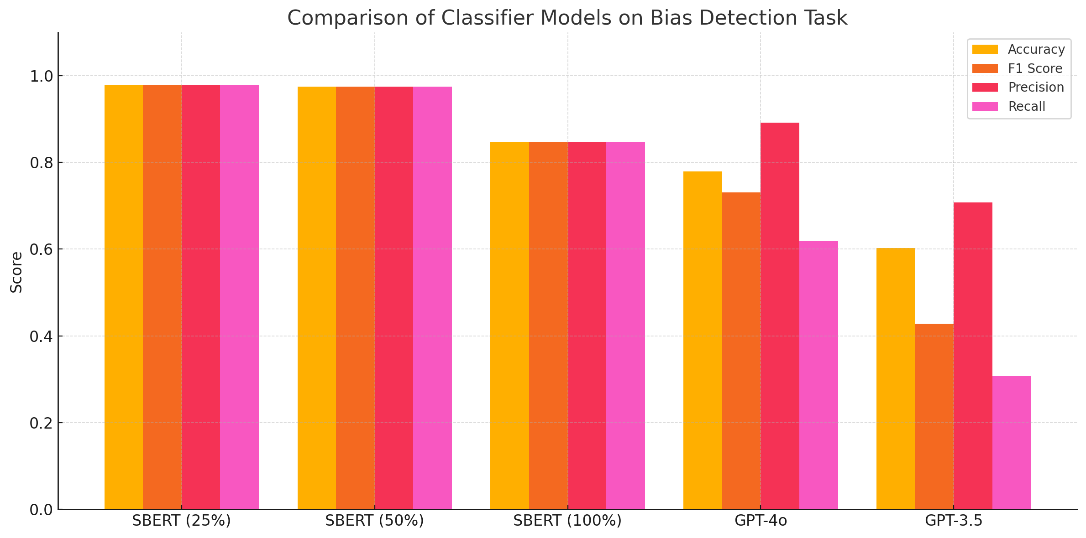
Results visualization and Conclusions
Notes:
15

Slide 16
Insights:
Fine-tuned SBERT models performed exceptionally well, achieving up to 97.4% accuracy, likely due to the similarity between our bias-detection task and SBERT’s NLI pretraining
Freezing 25% or 50% of SBERT layers gave almost identical results, showing that freezing half the model doesn't harm performance much and saves training resources
The 100% frozen model (classifier-only training) still reached ~84.7% accuracy, proving that the SBERT encoder already captures bias-related features well. As expected it performed the worst among the 3 sbert fine tuned models.
GPT-4o outperformed GPT-3.5 significantly (accuracy: 77.9% vs. 60.2%), but both were far behind the fine-tuned SBERT
GPT-4o’s high precision but lower recall suggests it was more cautious, detecting fewer biased cases but being more accurate when it did
Overall, fine-tuned SBERT models are the most reliable classifiers, while GPT models are less consistent and underperform without finetuning.
Results visualization and Conclusions
Notes:
16

Slide 17
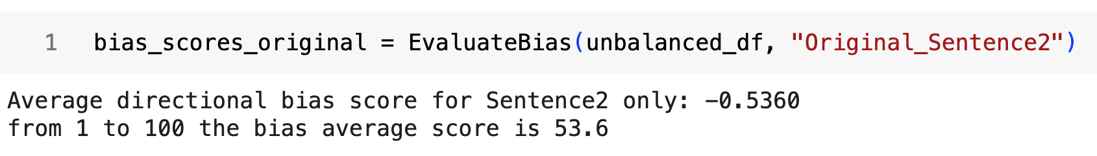
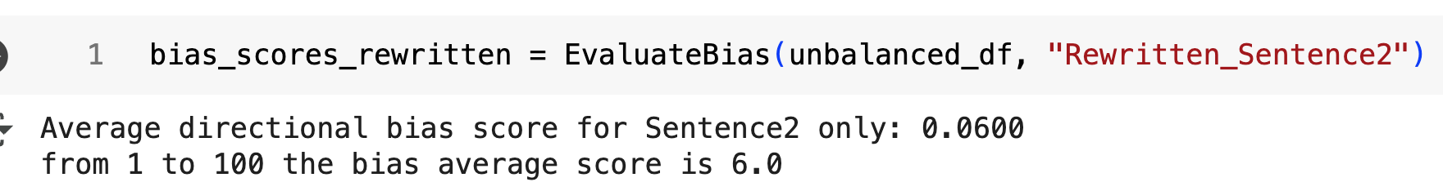
Rewrite Results
After we:
Chose a gender in 0.5 probaility
Created new Hypothesis for each biased sentence using Chat gpt4o with API loop and prompt instructions about the rewrite rules
Created a new dataset of the biased sentences with a new column of "rewritten sentence 2"
Run code for evaluation, using our special evaluation metric
We did not get the results we expected to get:
We got:
And found out that the reason for that was that our dataset was already balanced (about 50% male sentences and 50% female sentences).
So to test our method of balancing bias, we created another dataset, using 80% male sentences and 20% female sentences from the rewritten dataset, to make it unbalanced on purpose.
Then, after evaluaing our method on the unbalanced dataset we got:
Notes:
17

Slide 18
Rewrite Results and Conclusions
As we expected, before rewriting the bias average score was not very close to 0, but after rewriting, it became much closer to 0!
This proved our method worked correctly and balanced gender bias among both genders.
In addition, It showed that ChatGPT4o performed very well in rewriting the sentences and following our instructions
Notes:
18

Slide 19
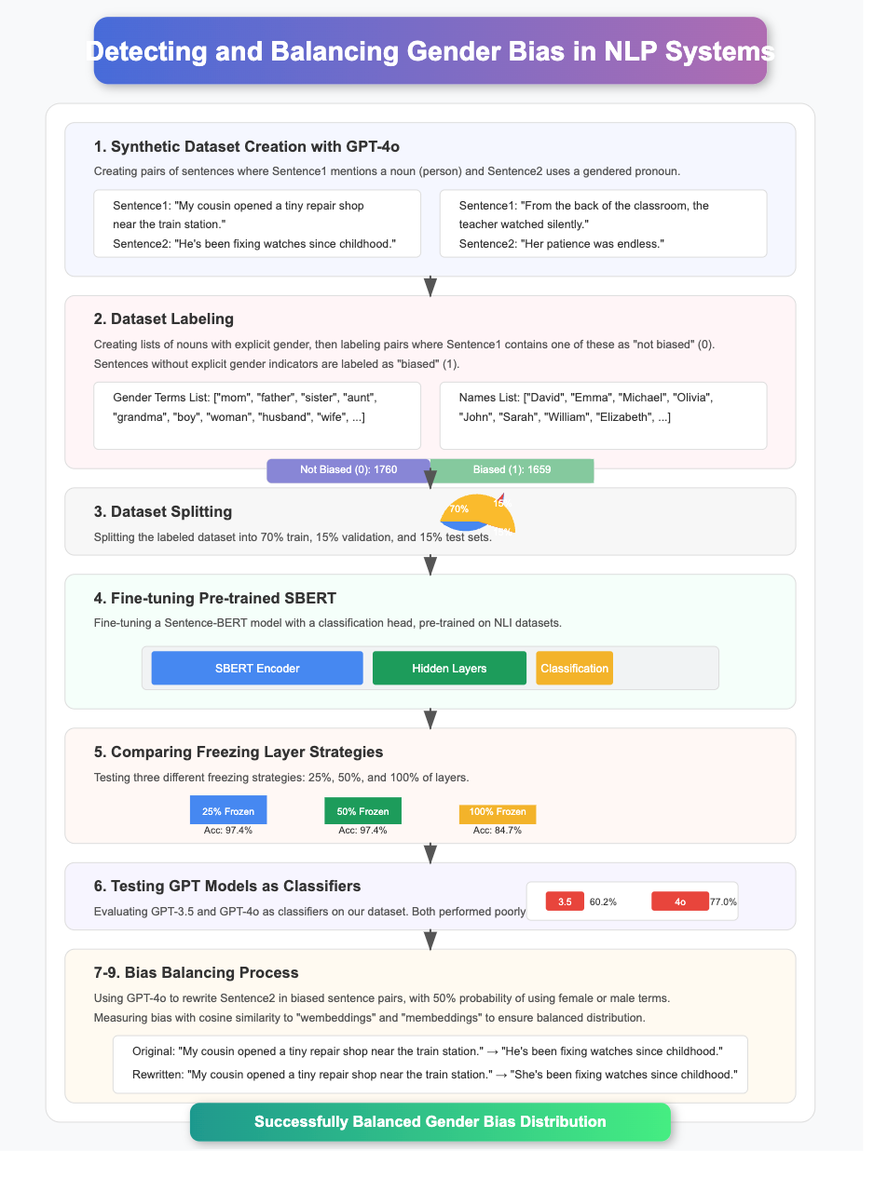
Visual Abstract

Slide 20
Visual Abstract – Zoom In

Slide 21
Visual Abstract – Zoom In

